Slide 1
Rust System Programming vulnerabilities using ML and Static analysis tools

Slide 2
Motivating Example: Securing Critical Rust Systems
Rust's growing adoption in system programming (OS, embedded, networking).
Real-world risks of vulnerabilities in these critical systems.
The need for advanced tools beyond Rust's inherent safety.
Example : A notable example is the early discovery of memory safety related bugs within the firefox browser, after some of its components were rewritten in Rust. While Rust helped to mitigate many common issues, it did not eliminate them all, highlighting that even in rust code, memory safety issues can still arise. These issues caused some crashes, until they were patched.
This shows us that even with rust, we need to have tools that find these issues, before they make it into production.

Slide 3
Research Questions: Enhancing Rust Security Analysis
Can ML identify vulnerability patterns in Rust code effectively?
How can static analysis validate and refine ML-driven results?
Can a hybrid approach reduce false positives and improve accuracy?
How to improve the automation of finding vulnerabilities.

Slide 4
Proposed Approach
Feature extraction from Rust code.
Training ML models for vulnerability classification.
Integrating static analysis tools (Clippy, Miri) for validation.
Generating a comprehensive vulnerability report.
Tools used: Rust language, linfa crate, ndarray crate, csv crate.

Slide 5
Experimental Method & Current Progress
Implemented data reading from CSV using the csv crate.
Trained and executed ML models (Decision Tree, Logistic Regression, K-Means, Linear Regression) using the linfa crate.
Generated a vulnerability report based on ML predictions.
Basic model evaluation implemented.
Used a limited synthetic CSV dataset for initial testing.

Slide 6
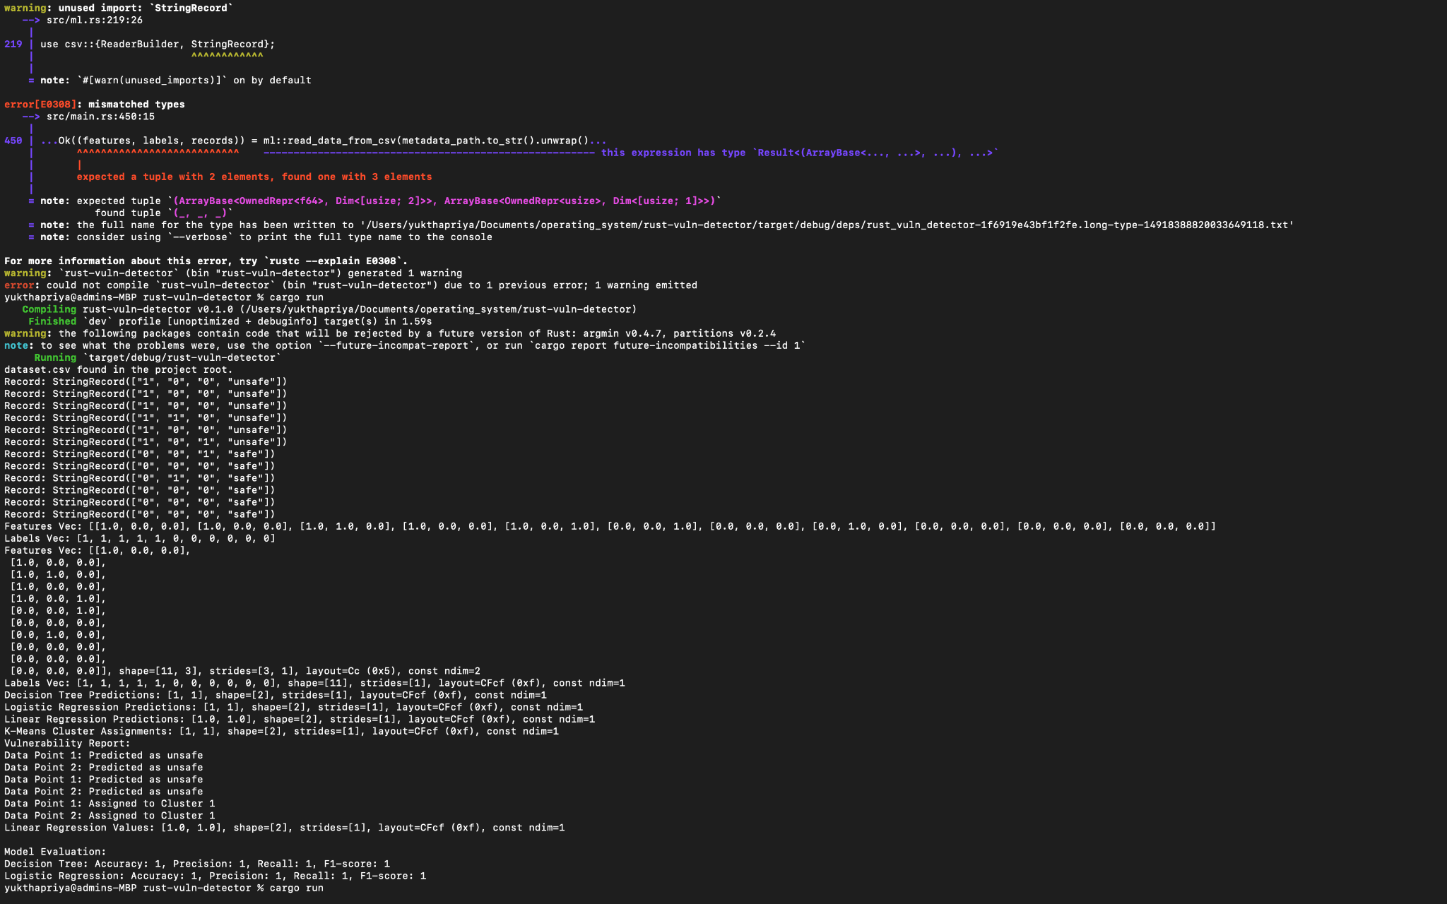

Slide 7
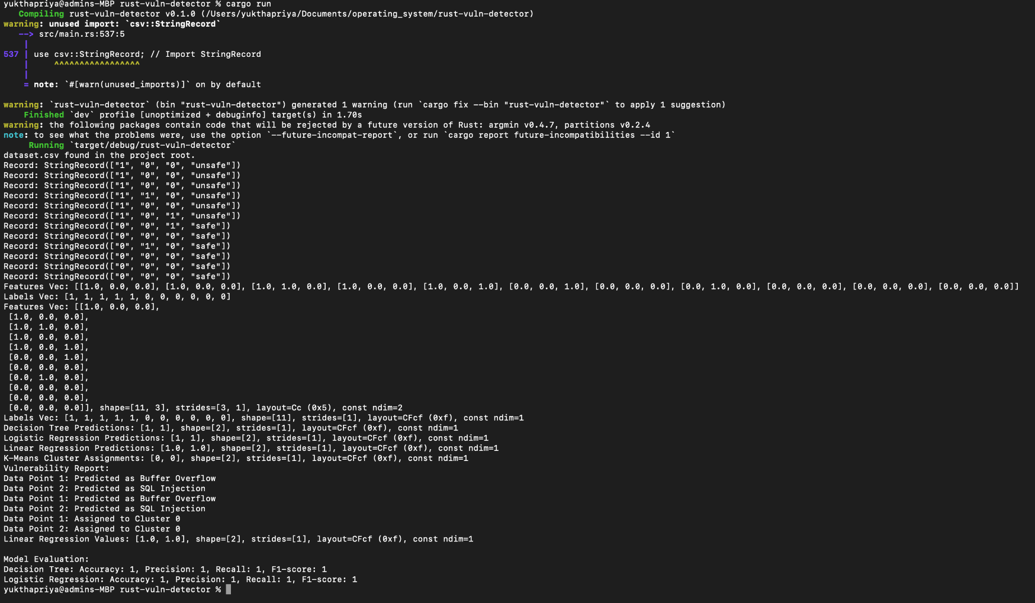

Slide 8
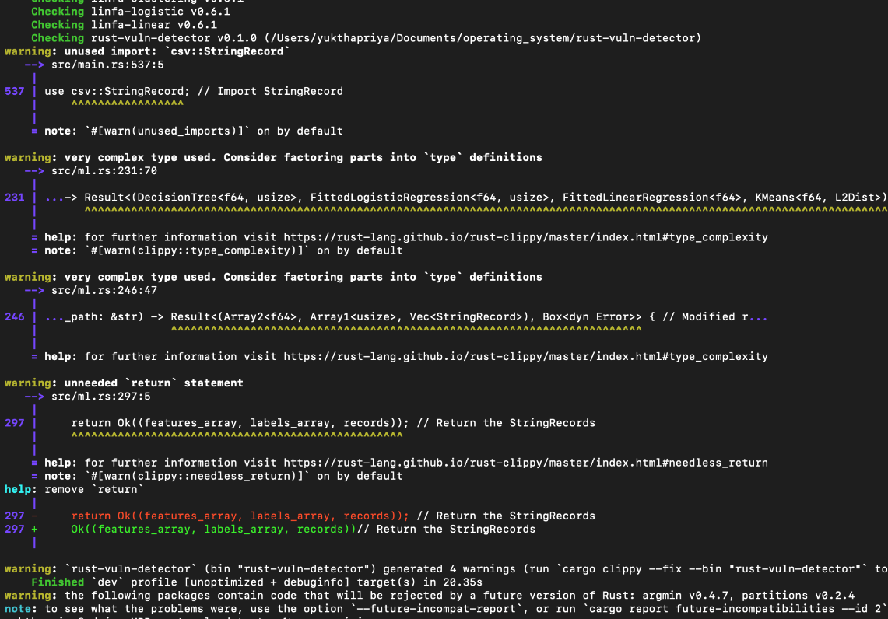
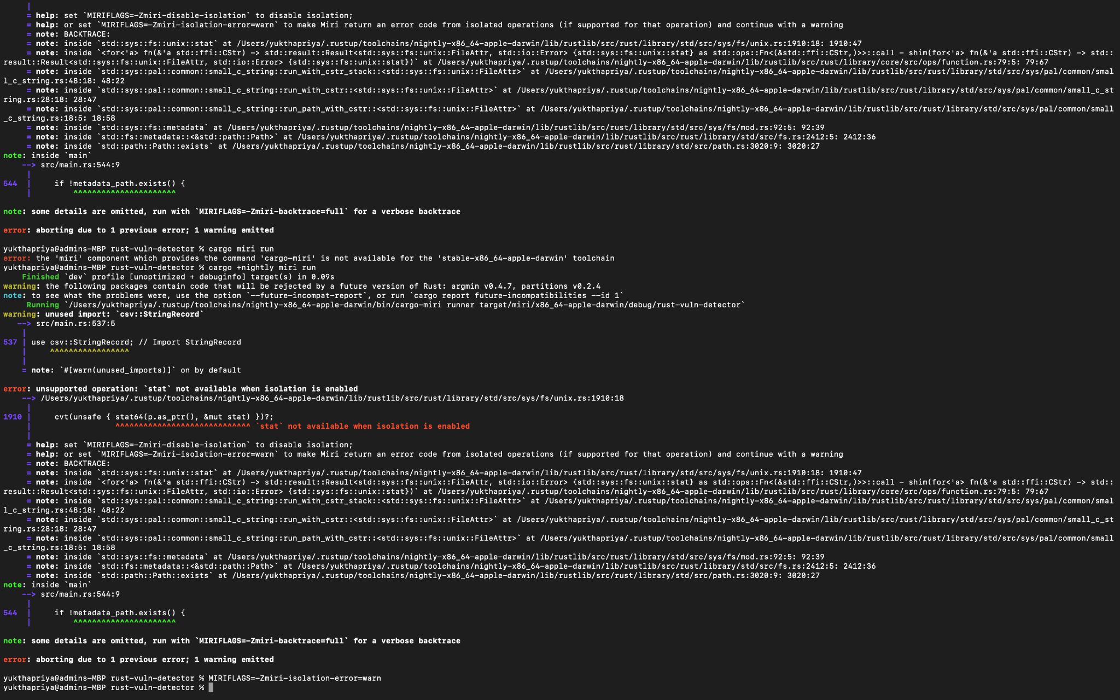
Clippy helps identify code style and potential issues.
Miri helps detect undefined behavior, but has isolation restrictions.

Slide 9
Expected Outcomes
Improved vulnerability detection accuracy.
Reduced false positives compared to static analysis alone.
Faster identification of potential security risks.
Future work: integration of static analysis tools, larger datasets, more advanced ML models.

Slide 10
Questions ?

